Slide 1
CAP442 Web Technology
Unit III
Session 7
II Year M.C.A

Slide 2
Contents
Introduction to PHP
Expressions and Control flow
PHP functions and objects
Arrays
Form handling
Introduction to MySQL
Accessing MySQL using PHP
Cookies, Sessions and Authentication

Slide 3
MySQL Basics
A database is a structured collection of records or data stored in a computer system and organized in such a way that it can be quickly searched and information can be rapidly retrieved.
MySQL is a widely used relational database management system (RDBMS).
MySQL is free and open-source.
The SQL in MySQL stands for Structured Query Language.
This language is loosely based on English and also used in other databases such as Oracle and Microsoft SQL Server.
It is designed to allow simple requests from a database via commands such as:
SELECT title FROM publications WHERE author = 'Charles Dickens';

Slide 4
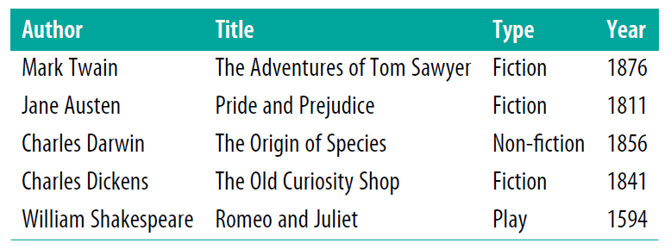
A MySQL database contains one or more tables, each of which contains records or rows.
Within these rows are various columns or fields that contain the data itself

Slide 5
Summary of Database Terms
The main terms you need to acquaint yourself with for now are as follows:
Database
The overall container for a collection of MySQL data
Table
A subcontainer within a database that stores the actual data
Row
A single record within a table, which may contain several fields
Column
The name of a field within a row

Slide 6
Command-Line Interface
To display all databases in mysql use the following command
SHOW databases;

Slide 7
The semicolon
The semicolon is used by MySQL to separate or end commands.
If you forget to enter it, MySQL will issue a prompt and wait for you to do so.
The required semicolon was made part of the syntax to let you enter multiple-line commands, which can be convenient because some commands get quite long.
It also allows you to issue more than one command at a time by placing a semicolon after each one.
The interpreter gets them all in a batch when you press the Enter (or Return) key and executes them in order.

Slide 8
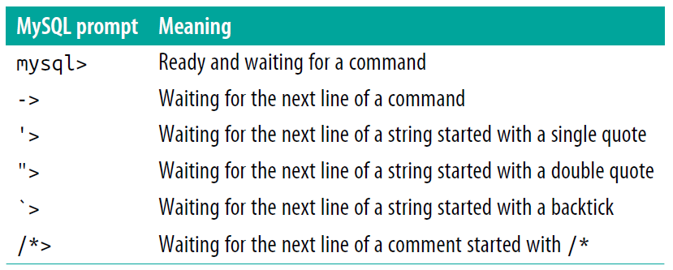
There are six different prompts in MySQL

Slide 9
Canceling a command
To cancel current command in prompt enter \c and press Return.
meaningless gibberish to mysql \c
When you type that line, MySQL will ignore everything you typed and issue a new prompt.
Without the \c, it would have displayed an error message.
If you have opened a string or comment, close it first before using the \c or MySQL will think the \c is just part of the string.
this is "meaningless gibberish to mysql" \c
Also note that using \c after a semicolon will not cancel the preceding command, as it is then a new statement.

Slide 10
MySQL Commands
Command Action
ALTER Alter a database or table
BACKUP Back up a table
\c Cancel input
CREATE Create a database
DELETE Delete a row from a table
DESCRIBE Describe a table’s columns
DROP Delete a database or table
EXIT (Ctrl-C) Exit
GRANT Change user privileges
HELP (\h, \?) Display help
INSERT Insert data
LOCK Lock table(s)
QUIT (\q) Same as EXIT
RENAME Rename a table
SHOW List details about an object
SOURCE Execute a file
STATUS (\s) Display the current status
TRUNCATE Empty a table
UNLOCK Unlock table(s)
UPDATE Update an existing record
USE Use a database

Slide 11
Points to remember about MySQL commands:
SQL commands and keywords are case-insensitive. CREATE, create, and CrEaTe all mean the same thing. However, for the sake of clarity, you may prefer to use uppercase for commands.
Table names are case-sensitive on Linux and macOS, but case-insensitive on Windows. So, for the sake of portability, you should always choose a case and stick to it. The recommended style is to use lowercase for table names.

Slide 12
Creating a database
Before creating any tables, first database must be created
CREATE DATABASE publications;
A successful command will return a message “Query OK, 1 row affected (0.00 sec)”
To work with it, issue the following command:
USE publications;
This will display the message “Database changed”

Slide 13
Creating a table
The CREATE TABLE statement is used to create a new table in a database.
CREATE TABLE table_name ( column1 datatype, column2 datatype, column3 datatype, .... );

Slide 14
Example:
CREATE TABLE classics (
author VARCHAR(128),
title VARCHAR(128),
type VARCHAR(16),
year CHAR(4) );
MySQL then issues the response “Query OK, 0 rows affected”
To check whether new table has been created, type the following:
DESCRIBE classics;

Slide 15
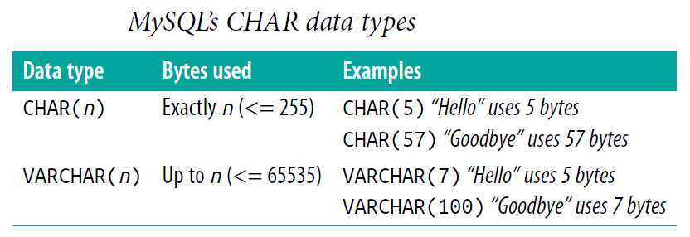
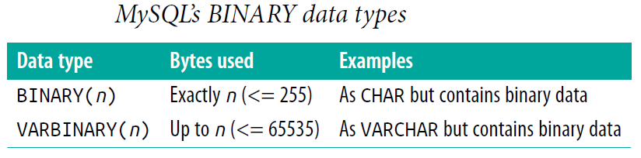
Data Types

Slide 16
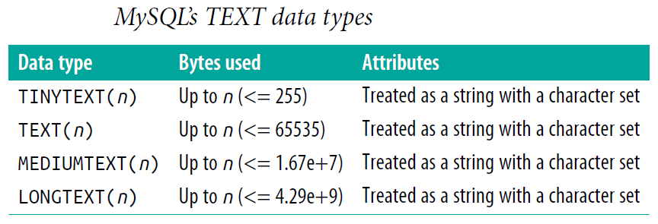
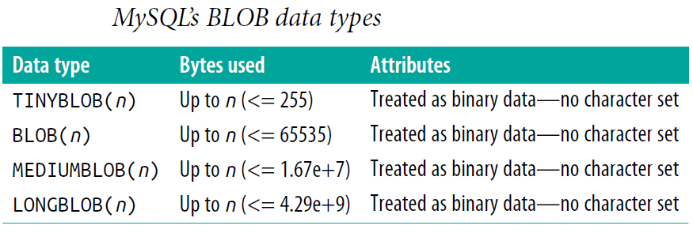

Slide 17
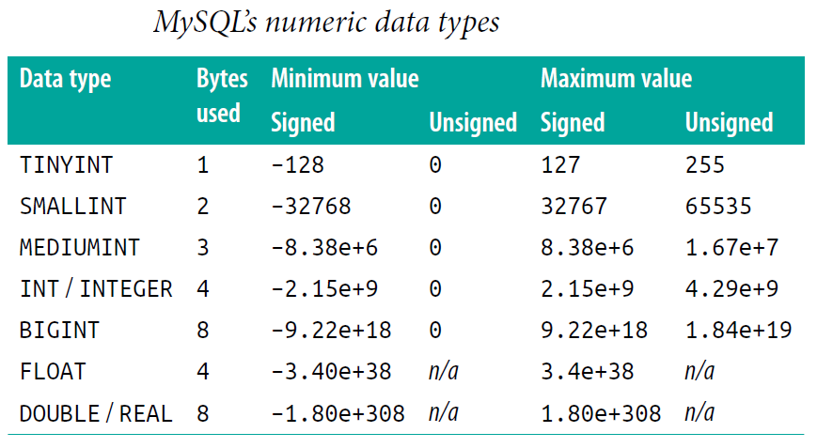

Slide 18
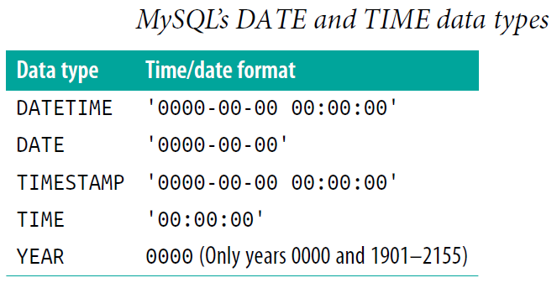

Slide 19
Adding data to a table
To add data to a table, use the INSERT command.
It is possible to write the INSERT INTO statement in two ways:
Specifying both the column names and the values to be inserted:
INSERT INTO table_name (column1, column2, column3, ...)
VALUES (value1, value2, value3, ...);
To add values for all the columns, no need to specify the column names. The order of the values must be is in the same order as the columns in the table.
INSERT INTO table_name
VALUES (value1, value2, value3, ...);

Slide 20
Populating the classics table
INSERT INTO classics(author, title, type, year)
VALUES('Mark Twain','The Adventures of Tom Sawyer','Fiction','1876');
INSERT INTO classics(author, title, type, year)
VALUES('Jane Austen','Pride and Prejudice','Fiction','1811');
INSERT INTO classics(author, title, type, year)
VALUES('Charles Darwin','The Origin of Species','Non-Fiction','1856');
INSERT INTO classics(author, title, type, year)
VALUES('Charles Dickens','The Old Curiosity Shop','Fiction','1841');
INSERT INTO classics(author, title, type, year)
VALUES('William Shakespeare','Romeo and Juliet','Play','1594');

Slide 21
Querying a MySQL Database
SELECT
SELECT command is used to extract data from a table.
SELECT column1, column2, ... FROM table_name;
Here, column1, column2, ... are the field names of the table you want to select data from.
To select all the fields available in the table,
SELECT * FROM table_name;
Example:
SELECT author,title FROM classics;

Slide 22
SELECT COUNT
It displays the number of rows in the table by passing * as a parameter, which means all columns
SELECT COUNT(*) FROM classics;
SELECT DISTINCT
Used to display data without duplicate values
SELECT author FROM classics;
SELECT DISTINCT author FROM classics;

Slide 24
DELETE
Used to remove a row from a table
Its syntax is similar to the SELECT command and allows you to narrow down the exact row or rows to delete using qualifiers such as WHERE and LIMIT.
DELETE FROM tablename WHERE condition;
DELETE FROM classics WHERE title='Little Dorrit';
This example issues a DELETE command for all rows whose title column contains the string ‘Little Dorrit’.

Slide 25
WHERE
The WHERE keyword is used to narrow down queries
It returns rows only those where a certain expression is true.
SELECT author,title FROM classics WHERE author="Mark Twain";
SELECT author,title FROM classics WHERE year=1857;

Slide 26
LIKE
Used to perform pattern matching searches
Allows searches on parts of strings.
This qualifier should be used with a % character before or after some text.
When placed before a keyword, % means anything before. After a keyword, it means anything after.
SELECT author,title FROM classics WHERE author LIKE "Charles%";
SELECT author,title FROM classics WHERE title LIKE "%Species";
SELECT author,title FROM classics WHERE title LIKE "%and%";

Slide 27
LIMIT
Used to choose how many rows to return in a query, and where in the table to start returning them.
When passed a single parameter, it tells MySQL to start at the beginning of the results and just return the number of rows given in that parameter.
If you pass it two parameters, the first indicates the offset from the start of the results where MySQL should start the display, and the second indicates how many to return.
SELECT author,title FROM classics LIMIT 3;
SELECT author,title FROM classics LIMIT 1,2;
SELECT author,title FROM classics LIMIT 3,1;

Slide 28
UPDATE...SET
Used to update the contents of a field
To change the contents of one or more fields, first narrow in on just the field or fields to be changed, in much the same way the SELECT command
UPDATE classics SET author='Mark Twain (Samuel Langhorne Clemens)'
WHERE author='Mark Twain';
UPDATE classics SET category='Classic Fiction'
WHERE category='Fiction';

Slide 29
ORDER BY
Used to sort the returned results by one or more columns in ascending or descending order.
SELECT author,title FROM classics ORDER BY author;
SELECT author,title FROM classics ORDER BY title DESC;

Slide 30
GROUP BY
In a similar fashion to ORDER BY, results returned from queries can be grouped using GROUP BY, which is good for retrieving information about a group of data.
For example, to know how many publications there are of each category in the classics table, the following query can be issued:
SELECT category,COUNT(author) FROM classics GROUP BY category;

Slide 31
Using Logical Operators
Logical operators AND, OR, and NOT can be used in MySQL WHERE queries to further narrow down selections
SELECT author,title FROM classics WHERE
author LIKE "Charles%" AND author LIKE "%Darwin";
SELECT author,title FROM classics WHERE
author LIKE "%Mark Twain%" OR author LIKE "%Samuel Langhorne Clemens%";
SELECT author,title FROM classics WHERE
author LIKE "Charles%" AND author NOT LIKE "%Darwin";

Slide 32
Renaming a table
Renaming a table, like any other change to the structure or meta-information about a table, is achieved via the ALTER command.
ALTER TABLE classics RENAME pre1900;

Slide 33
Changing the data type of a column
Changing a column’s data type also makes use of the ALTER command, in conjunction with the MODIFY keyword.
To change the data type of the column year from CHAR(4) to SMALLINT (which requires only 2 bytes of storage and so will save disk space)
ALTER TABLE classics MODIFY year SMALLINT;

Slide 34
Adding a new column
Used to add an additional column to already existing table.
ALTER TABLE classics ADD pages SMALLINT UNSIGNED;
Renaming a column
Used to change the column name of an already existing table
ALTER TABLE classics CHANGE type category VARCHAR(16);

Slide 35
Removing a column
Used to delete a column from already existing table
ALTER TABLE classics DROP pages;
Deleting a table
Deleting a table is very easy indeed.
CREATE TABLE disposable(c1 int, c2 varchar(20));
DESCRIBE disposable;
DROP TABLE disposable;
SHOW tables;

Slide 36
Creating an Index
The way to achieve fast searches is to add an index, either when creating a table or at any time afterward
ALTER TABLE classics ADD INDEX(author(20));
CREATE INDEX author ON classics (author(20));

Slide 37
Primary Keys
Primary key is an attribute or set of attributes used to uniquely identify a rown in a table.
ALTER TABLE classics ADD isbn CHAR(13) PRIMARY KEY;

Slide 38
Creating a FULLTEXT index
FULLTEXT index allows super-fast searches of entire columns of text.
It stores every word in every data string in a special index that you can search using “natural language,” in a similar manner to using a search engine.
FULLTEXT indexes can be created for CHAR, VARCHAR, and TEXT columns only.
A FULLTEXT index definition can be given in the CREATE TABLE statement when a table is created, or added later using ALTER TABLE (or CREATE INDEX).
ALTER TABLE classics ADD FULLTEXT(author,title);

Slide 39
Joining Tables Together
It is quite normal to maintain multiple tables within a database, each holding a different type of information.
For example, consider the case of a customers table that needs to be able to be cross-referenced with publications purchased from the classics table.
CREATE TABLE customers (
name VARCHAR(128),
isbn VARCHAR(13),
PRIMARY KEY (isbn)) ENGINE InnoDB;

Slide 40
INSERT INTO customers(name,isbn)
VALUES('Joe Bloggs','9780099533474');
INSERT INTO customers(name,isbn)
VALUES('Mary Smith','9780582506206');
INSERT INTO customers(name,isbn)
VALUES('Jack Wilson','9780517123201');
SELECT * FROM customers;

Slide 41
Joining two tables into a single SELECT
SELECT name,author,title FROM customers,classics
WHERE customers.isbn=classics.isbn;
NATURAL JOIN
Natural join takes two tables and automatically joins columns that have the same name.
SELECT name,author,title FROM customers NATURAL JOIN classics;

Slide 42
JOIN...ON
Used to specify the column on which to join two tables
SELECT name,author,title FROM customers
JOIN classics ON customers.isbn=classics.isbn;
Using AS
Used to create aliases to the tables
SELECT name,author,title from
customers AS cust, classics AS class WHERE cust.isbn=class.isbn;

Slide 43
Creating users
To create a user, issue the GRANT command, which takes the following form.
GRANT PRIVILEGES ON database.object TO 'username'@'hostname'
IDENTIFIED BY 'password';
Example parameters for the GRANT command
Arguments Meaning
*.* All databases and all their objects
database.* Only the database called database and all its objects
database.object Only the database called database and its object called object

Slide 44
Let’s create a user who can access just the new publications database and all its objects, by entering the following (replacing the username jim and also the password mypasswd with ones of your choosing):
GRANT ALL ON publications.* TO 'jim'@'localhost'
IDENTIFIED BY 'mypasswd';

Slide 45
References
https://www.w3schools.com/PHP/default.asp
Robin Nixon, Learning PHP, MySQL, JavaScript, CSS & HTML5, Oreilly, Third Edition, 2014.

